Slide 1
CSS
Responsive Web Design

Slide 2


Automatic views on Devices
Desktop | Phone

Slide 3
Responsive Web Design
Responsive web design makes your web page look good on all devices.
Responsive web design uses only HTML and CSS.
Responsive web design is not a program or a JavaScript.
It is called responsive web design when you use CSS and HTML to resize, hide, shrink, enlarge, or move the content to make it look good on any screen.
Throught the slides, if the CSS property is preceded with a period (.), it denotes that the property is a class

Slide 4
The Viewport
The viewport is the user's visible area of a web page.
The viewport varies with the device, and will be smaller on a mobile phone than on a computer screen.
Before tablets and mobile phones, web pages were designed only for computer screens, and it was common for web pages to have a static design and a fixed size.
Then, when we started surfing the internet using tablets and mobile phones, fixed size web pages were too large to fit the viewport. To fix this, browsers on those devices scaled down the entire web page to fit the screen.

Slide 5
Setting the Viewport
HTML5 introduced a method to let web designers take control over the viewport, through the <meta> tag.
<meta name="viewport" content="width=device-width, initial-scale=1.0">
A <meta> viewport element gives the browser instructions on how to control the page's dimensions and scaling.
The width=device-width part sets the width of the page to follow the screen-width of the device (which will vary depending on the device).
The initial-scale=1.0 part sets the initial zoom level when the page is first loaded by the browser.

Slide 6
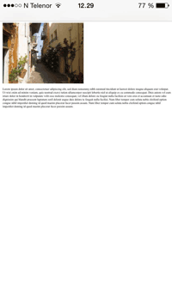
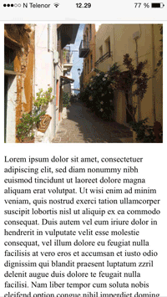
Effects of Viewport
Without the viewport meta tag | With the viewport meta tag

Slide 7
Form Elements
Method | Tag
Textbox | <input type= "text">
Radio Button | <input type= "radio">
Check Box | <input type= "checkbox">
Hidden | <input type= "hidden">
Text area | <textarea>..</textarea>
List down box | <select>..</select>
Password | <input type= "password"> When any text is written in this type of input box, ‘*’ will appear.

Slide 8
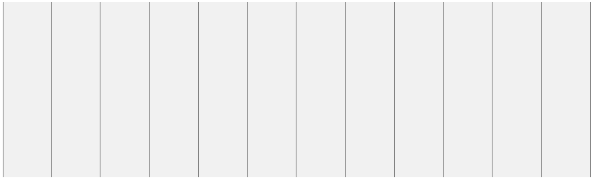
What is a Grid-View?
Many web pages are based on a grid-view, which means that the page is divided into columns:

Slide 9
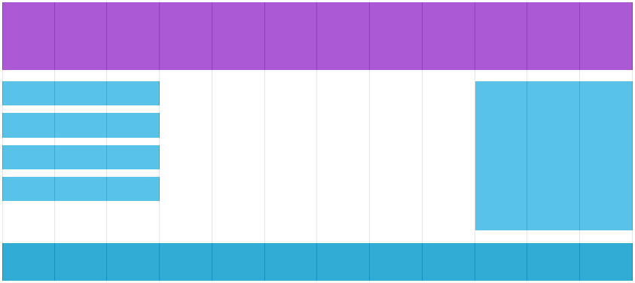
What is a Grid-View?
Using a grid-view is very helpful when designing web pages. It makes it easier to place elements on the page.
A responsive grid-view often has 12 columns, and has a total width of 100%, and will shrink and expand as you resize the browser window.

Slide 10
Building a Responsive Grid-View
ensure all HTML elements have the box-sizing property set to border-box. This ensures the padding and border are included in the total width and height of the elements.
The example is fine with two columns
but to use the 12 columns, proceed below
First we must calculate the percentage for
one column: 100% / 12 columns = 8.33%.
Then we make one class for each of the 12
columns, class="col-" and a number defining
how many columns the section should span:
* {
box-sizing: border-box;
}
.menu {
width: 25%;
float: left;
}
.main {
width: 75%;
float: left;
}

Slide 11
Building a Responsive Grid-View
.col-1 {width: 8.33%;}
.col-2 {width: 16.66%;}
.col-3 {width: 25%;}
.col-4 {width: 33.33%;}
.col-5 {width: 41.66%;}
.col-6 {width: 50%;}
.col-7 {width: 58.33%;}
.col-8 {width: 66.66%;}
.col-9 {width: 75%;}
.col-10 {width: 83.33%;}
.col-11 {width: 91.66%;}
.col-12 {width: 100%;}
[class*="col-"] {
float: left;
padding: 15px;
border: 1px solid red;
}
<div class="row">
<div class="col-3">
...</div>
<!-- 25% -->
<div class="col-9">
...</div>
<!-- 75% -->
</div>
CSS
CSS
HTML

Slide 12
Media Query
Media query is used to determine the size of the screen
Eg: If the browser window is 600px or smaller, the background color will be lightblue
In this example, the breakpoint is set at 600px
@media only screen and (max-width: 600px) {
body {
background-color: lightblue;
}
}

Slide 13
Media Query : Breakpoint
Breakpoints are used to as a determiner for the web site to display a different view
The rule of thumb is to set a breakpoint at 768px
/* For desktop: */
.col-1 {width: 8.33%;}
.col-2 {width: 16.66%;}
.col-3 {width: 25%;}
.col-4 {width: 33.33%;}
.col-5 {width: 41.66%;}
.col-6 {width: 50%;}
.col-7 {width: 58.33%;}
.col-8 {width: 66.66%;}
.col-9 {width: 75%;}
.col-10 {width: 83.33%;}
.col-11 {width: 91.66%;}
.col-12 {width: 100%;}
@media only screen and (max-width: 768px) {
/* For mobile phones: */
[class*="col-"] {
width: 100%;
}
}

Slide 14
Media Query : Breakpoint
Switches to desktop view then screen size exceeds 768px
Desktop | Phone

Slide 15

Media Query : Breakpoint
Always start with smaller size first
Phone (<600px) | Tablet (600px) | Desktop (786px)

Slide 16
Media Query : Breakpoint
/* For mobile phones: */
[class*="col-"] {
width: 100%;
}
@media only screen and (min-width: 600px) { /* For tablets: */
.col-s-1 {width: 8.33%;}
.col-s-2 {width: 16.66%;}
.col-s-3 {width: 25%;}
.col-s-4 {width: 33.33%;}
.col-s-5 {width: 41.66%;}
.col-s-6 {width: 50%;}
.col-s-7 {width: 58.33%;}
.col-s-8 {width: 66.66%;}
.col-s-9 {width: 75%;}
.col-s-10 {width: 83.33%;}
.col-s-11 {width: 91.66%;}
.col-s-12 {width: 100%;}
}
@media only screen and (min-width: 768px) { /* For desktop: */
.col-1 {width: 8.33%;}
.col-2 {width: 16.66%;}
.col-3 {width: 25%;}
.col-4 {width: 33.33%;}
.col-5 {width: 41.66%;}
.col-6 {width: 50%;}
.col-7 {width: 58.33%;}
.col-8 {width: 66.66%;}
.col-9 {width: 75%;}
.col-10 {width: 83.33%;}
.col-11 {width: 91.66%;}
.col-12 {width: 100%;}
}

Slide 17
Font
The font-family property sets the font for your page or the element of your choice
Bold, italic and normal is set through font-weight
/* One sets <p> to TNR, the other set body to Verdana */
p {
font-family: "Times New Roman", Times, serif;
}
body {
font-family: "Verdana";
}
p.thick { /* sets <p class="thick"> to bold */
font-weight: bold;
}
p {/* sets all <p> to italic*/
font-weight: italic;
}

Slide 18
Font
The size of the font is controlled by font-size property
Sizes may be expressed using px or em
1em is equivalent to 16px
p {
font-size: 14px;
}
p {
font-size: 0.875em; /* 14px/16=0.875em */
}

Slide 19
Variable Font Size
Font sizes may be set to display accordingly depending on the screen size
/* If the screen size is 601px or more, set the font-size of <div> to 80px */
@media only screen and (min-width: 601px) {
div.example {
font-size: 80px;
}
}
/* If the screen size is 600px or less, set the font-size of <div> to 30px */
@media only screen and (max-width: 600px) {
div.example {
font-size: 30px;
}
}

Slide 20
Images : Using The width Property
If the width property is set to a percentage and the height is set to "auto", the image will be responsive and scale up and down:
If the max-width property is set to 100%, the image will scale down if it has to, but never scale up to be larger than its original size:
img {
width: 100%;
height: auto;
}
img {
max-width: 100%;
height: auto;
}

Slide 21
HTML5 <picture> Element
With <picture> element, HTML lets you define more than one image.
The <picture> element works similar to the <audio> and <video> elements. You set up different sources, and the first source that fits the preferences is the one being used:
<picture>
<source srcset="img_smallflower.jpg" media="(max-width: 400px)">
<source srcset="img_flowers.jpg">
<img src="img_flowers.jpg" alt="Flowers">
</picture>

Slide 22
Video : Using The width Property
If the width property is set to 100%, the video player will be responsive and scale up and down:
If the max-width property is set to 100%, the video player will scale down if it has to, but never scale up to be larger than its original size:
video {
width: 100%;
height: auto;
}
video {
max-width: 100%;
height: auto;
}

Slide 23


CSS Tables
To specify table borders in CSS, use the border property.
The border-collapse property collapses table border into a single border
table, th, td {
border: 1px solid black;
}
table {
border-collapse: collapse;
}
table, th, td {
border: 1px solid black;
}

Slide 24
CSS Table
Horizontal alignment is set using text-align property.
Vertical alignment is set using vertical-align property.
th {
text-align: left; /* left, right or center */
}
td {
height: 50px;
vertical-align: bottom; /* top, bottom or center */
}

Slide 25

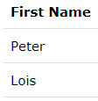
CSS Table
use the padding property on <td> and <th> elements to control the space between the border and content
Add the border-bottom property to <th> and <td> for horizontal dividers:
th, td {
padding: 15px;
text-align: left;
}
th, td {
border-bottom: 1px solid #ddd;
}

Slide 26
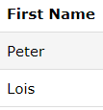
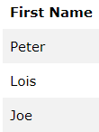
CSS Table
Use the :hover selector on <tr> to highlight table rows on mouse over in Hoverable Table
For zebra-striped tables, use the nth-child() selector and add a background-color to all even (or odd) table rows
tr:hover {background-color: #f5f5f5;}
/* Peter is slightly grey */
table {
border-collapse: collapse;
width: 100%; }
th {
height: 50px;
padding: 8px; }
tr:nth-child(even) {background-color: #f2f2f2;}

Slide 27
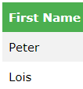

CSS Table
Background color and text color of <th> elements can be manipulated using CSS
Responsive table allows for horizontal scroll bar to be present if the screen size can not fit the table using overflow-x:auto
th {
background-color: #4CAF50;
color: white;
}
<div style="overflow-x:auto;">
<table>
... table content ...
</table>
</div>

